Slide 1
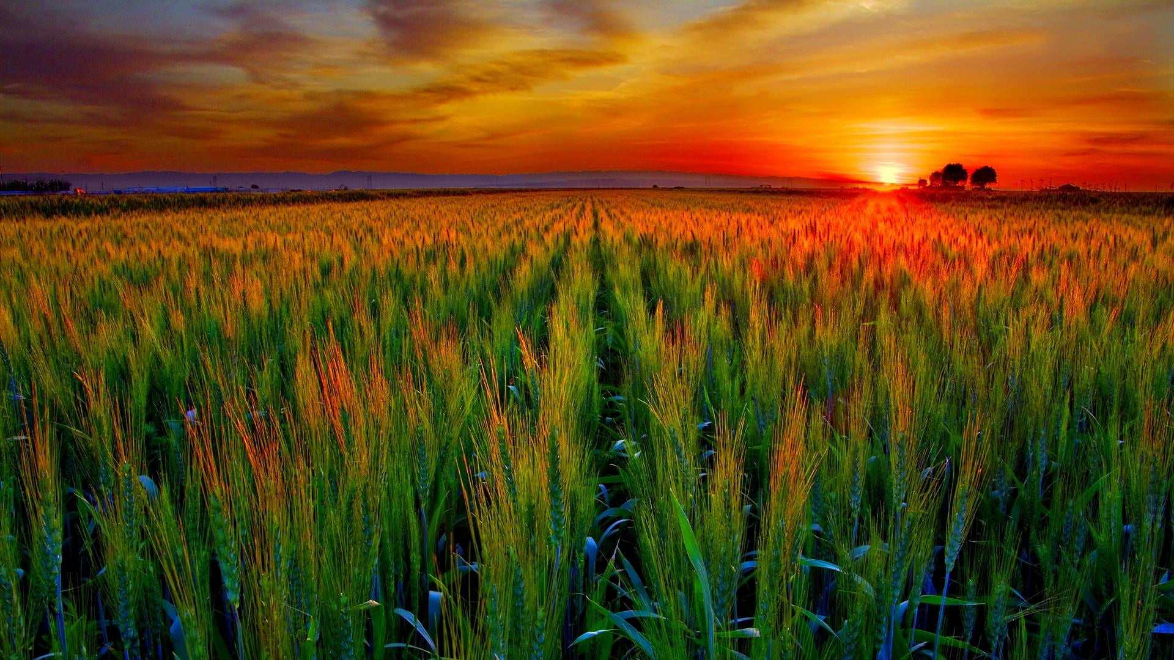

KHETI MITRA
खेती मित्र

Slide 2
PROBLEM STATEMENT
Agriculture faces challenges like changing weather, limited seed knowledge, no data-driven crop calendar, low tech adoption, and tech awareness gaps. Farmers need an integrated solution to thrive in this evolving landscape.
SOLUTION
"KhetiMitra" is a comprehensive solution that integrates real-time data, AI-driven insights, and user-friendly platforms to empower farmers. It effectively addresses challenges posed by shifting weather patterns, limited seed knowledge, and low tech adoption, fostering sustainability and resilience in agriculture.

Slide 3
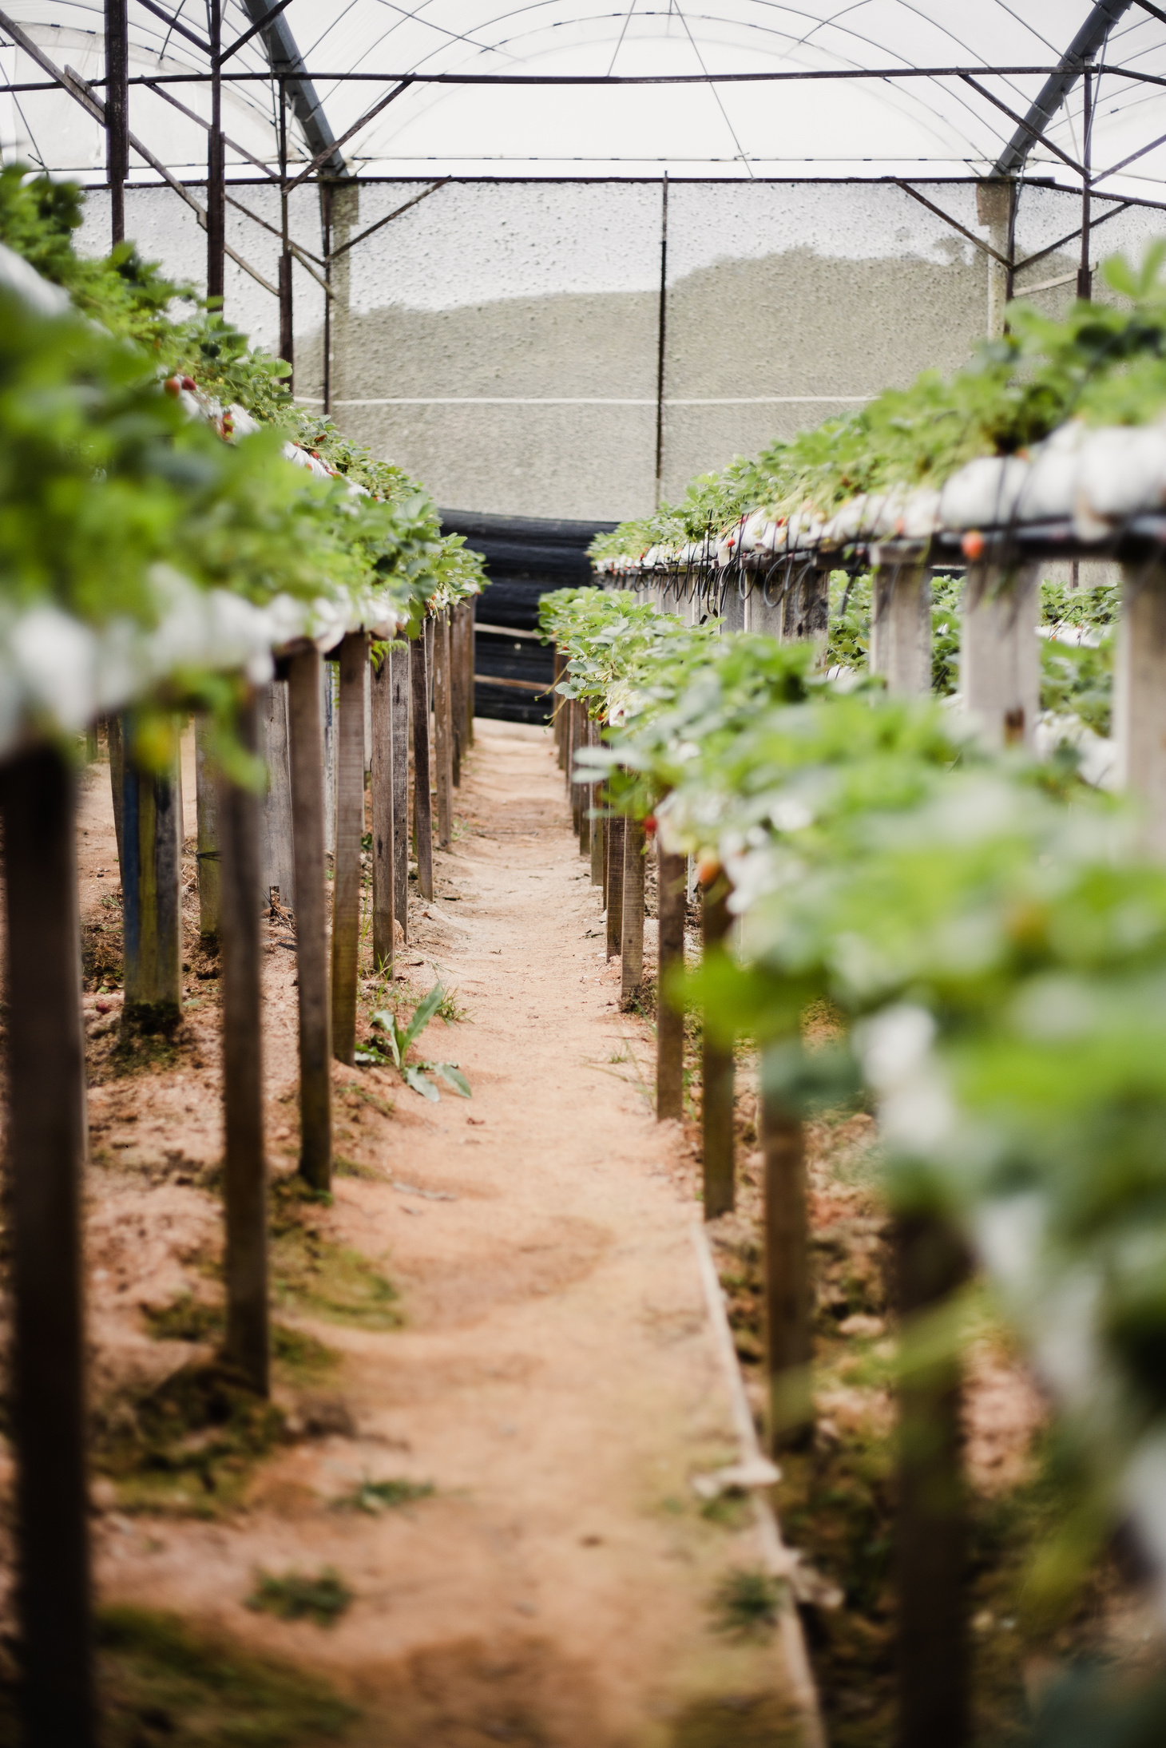
Solution
Overview
"KhetiMitra" empowers farmers with modern technology.
Real-time data, AI insights, user-friendly platforms.
Addresses weather challenges, seed knowledge gaps, and tech adoption.
Promotes sustainability and resilience in agriculture.
Fosters informed decision-making for farmers.

Slide 4

Value Proposition
"KhetiMitra, powered by WeatherTech data, offers substantial benefits. It boosts crop yields by 20%, saving farmers up to Rs. 1 lakh annually. Additionally, it reduces water usage by 15% and cuts pest-related losses by 10%. This results in a 25% increase in market profitability, enhancing farmers' financial prospects and promoting sustainable agriculture."
Weather & Soil Insights
AI Crop Recommendations
Market Price Predictions
Pest & Disease Alerts
Tech Adoption Guidance
AI-Powered Crop Calendar
Crop-specific SOPs for Maximum Yield

Slide 5
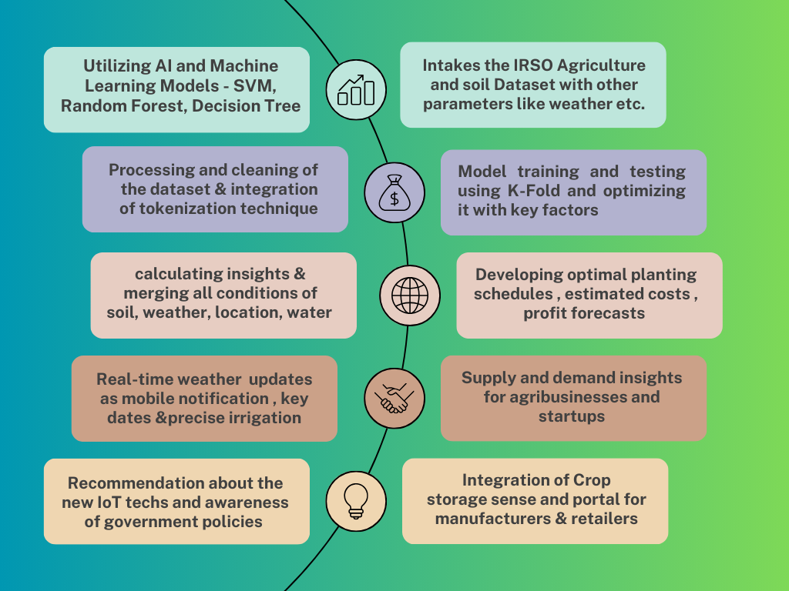
Flowchart of the AI Model

Slide 6

Feasiblility
Data Partnerships: Collaborate with data providers for real-time data.
AI Model Development: Create AI models for recommendations.
User-Friendly Platforms: Develop intuitive mobile and web tools.
Training Programs: Offer comprehensive user training.
Accessibility Focus: Ensure inclusivity for all farmers.

Slide 7

Uniqueness
Weather-Adaptive Planning: Real-time weather insights for adaptive farming.
AI Precision Farming: AI-driven precision in crop management.
Tailored SOPs: Customized Standard Operating Procedures for optimal yields.
Localized Recommendations: Region-specific crop advice.
Multi-Lingual Access: Inclusivity for diverse farming communities.
Real-time Insights: Immediate access to critical data.
Eco-Friendly Practices: Promotes sustainable farming.
Dynamic Learning: AI adapts to evolving conditions.

Slide 8
Impact and Sustainability
KhetiMitra's impact is multifaceted, contributing significantly to sustainability. Environmentally, it optimizes resource use, reducing the ecological footprint of agriculture. Socially, it enhances food security and empowers farming communities with knowledge. Economically, it fosters growth in the agricultural sector, strengthening the foundation of economic sustainability. KhetiMitra aligns seamlessly with the overarching theme of the hackathon, offering a holistic solution that propels agriculture into a more sustainable and prosperous future.
Environmental: KhetiMitra enhances crop yield efficiency, reducing the environmental footprint by optimizing resource use.
Social: Improved food security and knowledge empowerment uplift communities, aligning with social sustainability goals.
Economic: Economic growth in agriculture fosters financial sustainability among farmers.

Slide 9
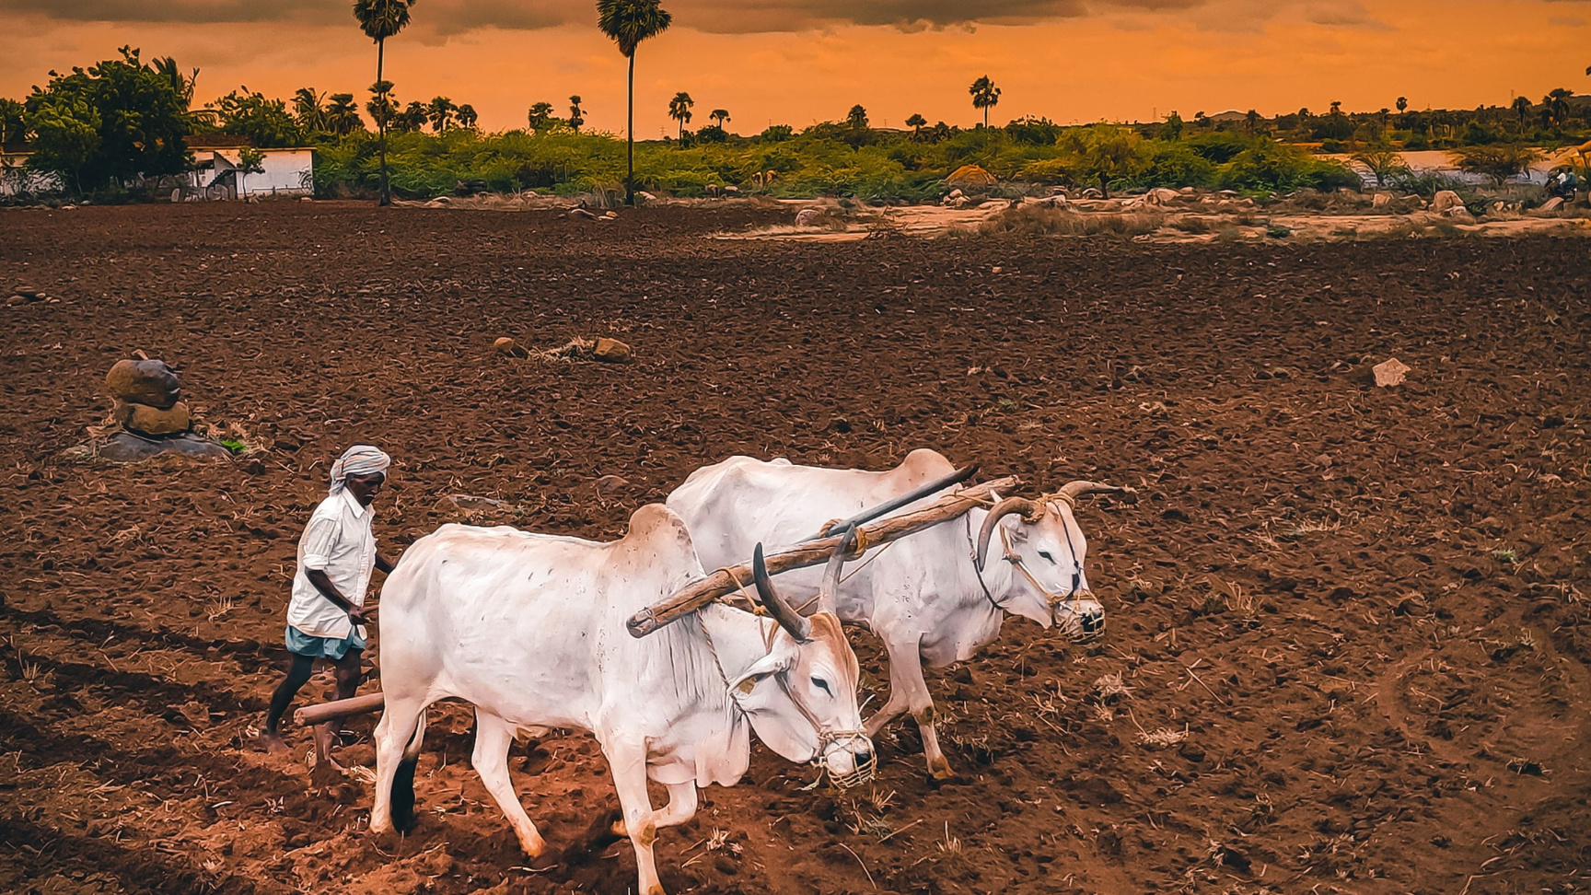
Environmental Benefits
Reduced Resource Consumption: KhetiMitra reduces water and pesticide usage, promoting resource efficiency.
Minimal Chemical Usage: By providing targeted insights, it minimizes chemical application, benefiting the environment.
Lower Carbon Footprint: Sustainable practices lead to a reduced carbon footprint, supporting environmental conservation.

Slide 10
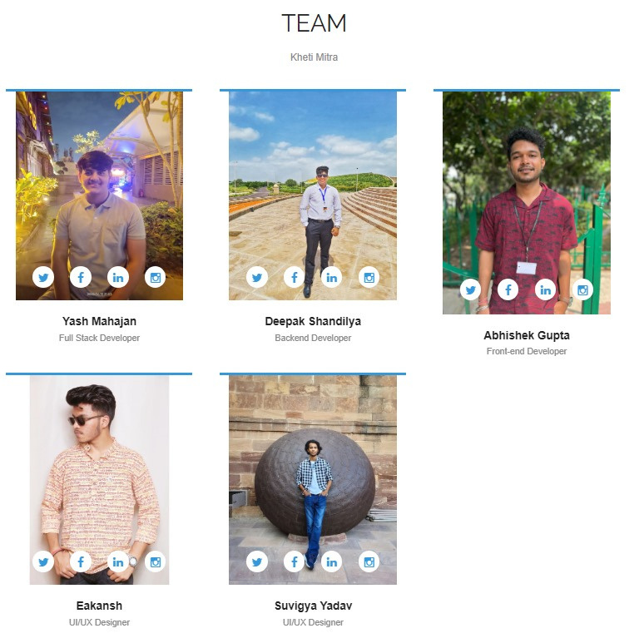
M
E
M
B
E
R
S
T
E
A
M

